Slide 1


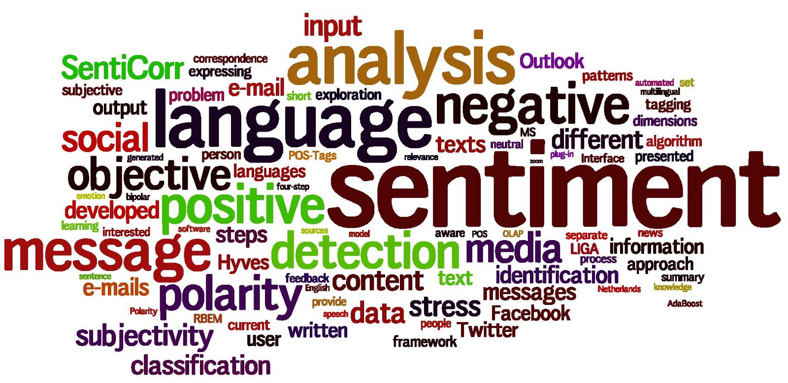
SENTIMENT ANALYSIS TWITTER
Neha, Nishant, Mayank

Slide 2
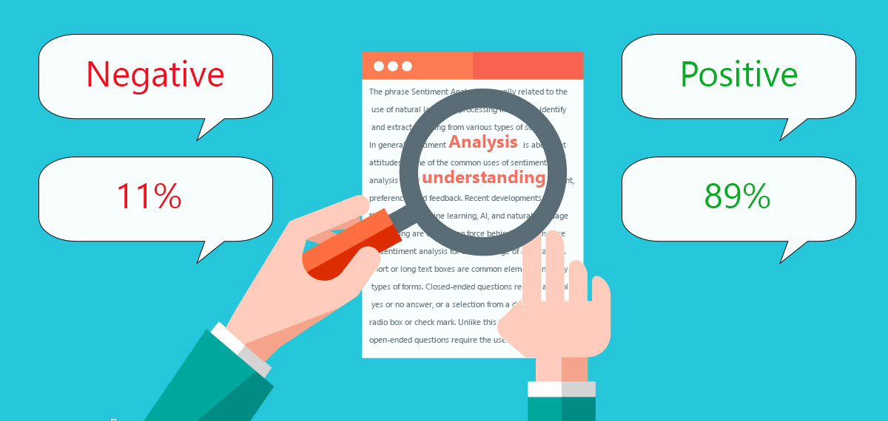
WHAT IS SENTIMENT ANALYSIS ?
Sentiment Analysis is the process of computationally identifying and categorizing opinions expressed in a piece of text, especially in order to determine whether the writer's attitude towards a particular topic, product, etc., is positive, negative, or neutral.

Slide 3
PROBLEM TO BE SOLVED
Credibility of a particular product or service is important to know as what people think about that
Growing resources such as online review sites and personal blogs are used by people to know and understand the reaction of people.
Many microblogging sites like Twitter generates millions of tweets on a daily basis.
Aim is to use data of twitter to find credibility regarding the particular product, topic etc.

Slide 4
WHY THIS PROBLEM IS IMPORTANT
“What other people think” has always been the main concern while we’re making the decisions.
Businesses spend a lot of money to obtain consumer opinions, using surveys, focus groups, opinion polls consultants.
Many people cast their opinions or experiences regarding the product they use, common topics etc. on websites.
With all the information available on web platform such as blogs, discussion, social media where people can find various opinions and product experience or service they are looking for it are positive or negative.
This application can be used by a company to check the image of their brand among customers. It will also help quantifying the present and potential customers. According to their brand’s image they can modify their marketing strategies.

Slide 5

STATE OF ART SOLUTION
Lexical Analysis
The lexical analyzer breaks the sentences into a series of tokens, by removing any whitespace or symbols in the source code.
Advantage: Data is cleaned properly
Disadvantage: Lot of noise, irreverent preprocess steps.
Opinion Digger
It is a statistical processes for estimating the relationships among words.
Advantage: Finds interaction between two words
Disadvantage: Needs a guideline

Slide 6
STATE OF ART SOLUTION
Data Mining and Sentiment Analysis
They take into consideration both the strength of an opinion as well as the relevance of an opinion
Major Advantages above other Techniques : The Dictionary is open source and new words are added at regular bases.

Slide 7



REQUIREMENTS
TextBlob
Tweepy
Impala
Hive
PySpark
Anaconda
Spyder

Slide 8
TEXTBLOB
Python library that offers simple API to access methods and perform basic NLP tasks.
Installed by: $ pip install textblob
Very easy to use and used in sentimental analysis for text analysis as well as extract subjective information in the tweets.
Provides two methods: Polarity and subjectivity for the analysis.

Slide 9
TEXTBLOB
Polarity is the float value within the range [-1.0 to 1.0] where 0 indicates neutral, 0.1 to 1.0 indicates positive sentiment and -0.1 to -1.0 indicates negative sentiment.
Subjectivity is the float value within the range[0.0 to 1.0] where 0.0 is very objective and 1.0 is very subjective.
Subjective sentence includes personal beliefs, views, opinions, beliefs, desires, allegations, suspicions etc.
Objective sentences are factual

Slide 10

TWEEPY
Tweepy is open-sourced, hosted on GitHub and enables Python to communicate with Twitter platform and use its API.
Why Tweepy? https://developer.twitter.com/en/docs/basics/rate-limiting.html
Uses Impala for fetching the streaming twitter data
Twitter has limitation on getting the Tweets
Tweepy is one of the few API’s that is allowed to have 100 requests per rate limit window

Slide 11

Anaconda - Spyder
Anaconda is a free and open-source distribution of the Python and R programming languages for data science and machine learning applications (large-scale data processing, predictive analytics, scientific computing), that aims to simplify package management and deployment.
Spyder is a powerful scientific environment written in Python, for Python, and designed by and for scientists, engineers and data analysts.

Slide 12

LET’S START
Open pyspark
import tweepy
from textblob import TextBlob
consumer_key= 'bLOuAZNzWvpy11Fpo747ycL6C'
consumer_secret= 'NCEacdi06y7kChDgs9LDhiS3tpoCbl9A3ApqnP7JKlRQC7w6Ge'
access_token='771274551892344832-f4pXF3Bu4T5Xx5UUpt9H4f72wtg18Wo'
access_token_secret='fiPTOrnD6QeLA8CZhsydiNiPJKiVS9hgBv9aOVfDIVyO8'

Slide 13
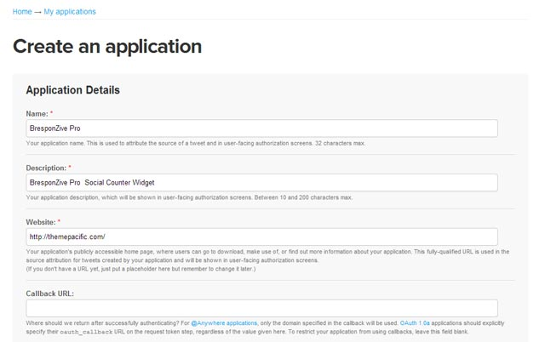
https://developer.twitter.com/en/docs/basics/authentication/guides/access-tokens.html

Slide 14
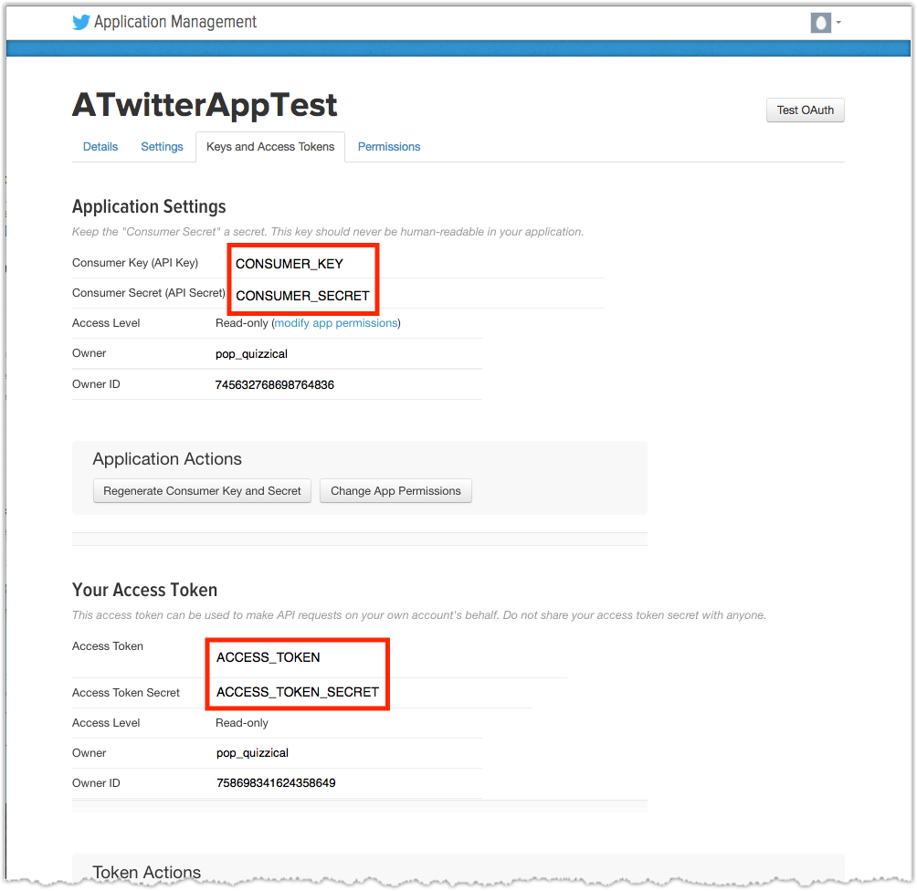

Slide 15
auth = tweepy.OAuthHandler(consumer_key, consumer_secret)
auth.set_access_token(access_token, access_token_secret)
api = tweepy.API(auth)
r = range(1,10)
l=[]
f= open("tweetNumber.txt","w+")
filter = "trump"

Slide 16
public_tweets = api.search(q=filter,count=100)
for tweet in public_tweets:
l.append(tweet.id)
t=tweet.text.encode('utf-8')
analysis = TextBlob(tweet.text)
polarity=analysis.sentiment.polarity
if polarity > 0: s="POSITIVE"
elif polarity < 0: s="NEGATIVE"
elif polarity == 0: s="NEUTRAL"
subjectivity=analysis.sentiment.subjectivity
f.write(tweet.id_str.encode('utf-8') + "," + s + "," + str(polarity) + "," + str(subjectivity) + "\n")

Slide 17
analysis = TextBlob(tweet.text)
polarity=analysis.sentiment.polarity
if polarity > 0: s="POSITIVE"
elif polarity < 0: s="NEGATIVE"
elif polarity == 0: s="NEUTRAL"
subjectivity=analysis.sentiment.subjectivity
f.write(tweet.id_str.encode('utf-8') + "," + s + "," + str(polarity) + "," + str(subjectivity) + "\n")
f.close()
l.sort()
for x in r:
l.sort()
small=l[0]-1
public_tweets = api.search(q=filter,count=100, max_id=small)
for tweet in public_tweets:
l.append(tweet.id)
t=tweet.text.encode('utf-8')

Slide 18

POLL
Predict the Result of Sentiment on “TRUMP”

Slide 19
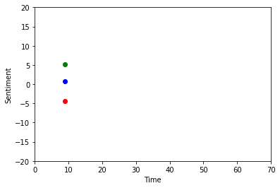
SENTIMENT ANALYSIS ON ANACONDA - SPYDER
https://www.youtube.com/watch?v=l9AC98amjSA
https://github.com/shreyans29/thesemicolon/blob/master/livesenti.py

Slide 20

CREATING A TABLE IN HIVE
create table tweet(id Bigint, sentiment String, polarity Double, subjectivity Double) Comment 'Twitter Details' ROW FORMAT DELIMITED FIELDS TERMINATED BY ',';
LOAD DATA LOCAL INPATH '/home/training/tweetNumber.txt' OVERWRITE INTO TABLE tweet;

Slide 21

CONNECTING HIVE WITH SPARK
sudo ln -s /usr/lib/hive/conf/hive-site.xml /usr/lib/spark/conf/hive-site.xml

Slide 22
BACK TO PYSPARK
from pyspark.sql import HiveContext
hc = HiveContext(sc)
positive = hc.sql("select * from tweet where sentiment == 'POSITIVE'")
negative = hc.sql("select * from tweet where sentiment == 'NEGATIVE'")

Slide 23
p = positive.map(lambda x:x)
n = negative.map(lambda x:x)
pP=(float(p.count())/(p.count()+n.count()))*100
print pP
nP=(float(n.count())/(p.count()+n.count()))*100
print nP

Slide 24

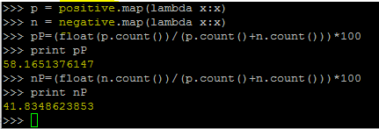
RESULT

Slide 25

ADVANTAGES AND DRAWBACKS OF PROPOSED SOLUTION
Advantages:
With correct sentimental analysis one can improve the quality of product based on the feedback which can be positive, negative or neutral.
Boost in the sales of company by delivering product according to customer expectations.
Disadvantages:
Abbreviations used in tweets is a problem
Grammatical skills like poor spelling, poor punctuation, poor grammar
Sarcasm used in the tweets
Cannot be applied on other languages except English

Slide 26

FUTURE SCOPE
Add Dictionary which are compatible with languages other than English. It is feasible as the Textblob is an open source library.

Slide 27


